Slide 1

Optimizing Marketing Strategies – Improving Operational Efficiency and Revenue generation
Case Study Group: Ankit Mathur, Lakshmi Sagar, Rakesh Kumar Sahoo, Rohit Vashishth
Group Name: ALRR0625

Slide 2

Agenda
1
Objective & Goals
2
Findings
3
Background
4
Insights and Recommendations
5
Recommendations
6
Appendix

Slide 3
Overview & Objectives
Business Overview
Namma Yatri plays a pivotal role in Bengaluru’s urban transport network. Operating in a dynamic environment, the company must continuously adapt to shifting demand patterns, optimize ride allocation, and maintain profitability — all while delivering a superior customer experience. To support this, Namma Yatri aims to deepen its understanding of ride patterns, customer behavior, and operational bottlenecks.
Objectives
The objective is to uncover insights that can guide decisions to improve service efficiency, maximize revenue, and enhance customer satisfaction through:
Identifying peak demand patterns and trends
Uncovering factors influencing cancellations and driver performance
Optimizing payment methods and trip durations
Improving resource allocation and marketing strategies

Slide 4
Background – Initial observations
Background
Peak demand patterns and trends – Afternoon and Forenoon
Cancellation rate stands at 23%
Driver performance – 88%
Payment method – Digital payments 74%
Low Conversion rate – 45%

Slide 5
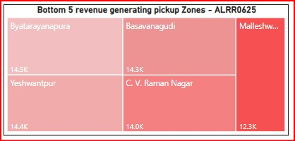
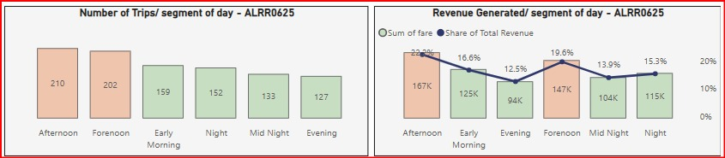
42% of revenue is generated during business hours
Insights
Maximum trips & revenue are between 7 AM to 5 PM
Time slot Midnight to 1 AM has the highest hourly revenue – 45K
Bottom 5 pickup zones contribute only 9.3% (69.5K) of total revenue

Slide 6
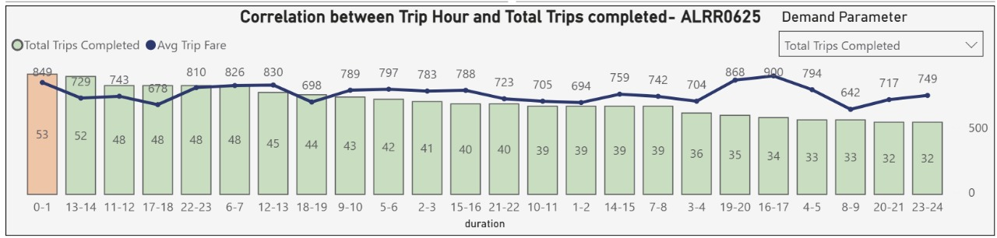
High fare duration slots remain underutilized
Insights
Top 5 durations - average fare wise: - 16-17, 19-20, 0-1, 6-7, 22-23
Early Morning Peak: 0-1 hour (12 AM - 1 AM) has the highest trip completion (849).
Stable Fares: Average trip fare remains consistently similar regardless of trip volume.
Mid-Day/Late-Night Dips: Trip completion is lowest during mid-day and late-night hours.
Fare Spikes During Off-Peak Hours: While overall fares are stable, the "Avg Trip Fare" experiences noticeable increases during 16-17, 19-20, and 4-5 hours. These are times when "Total Trips Completed" are relatively lower compared to the peak, suggesting potential surge pricing or higher value trips during these less busy periods.

Slide 7
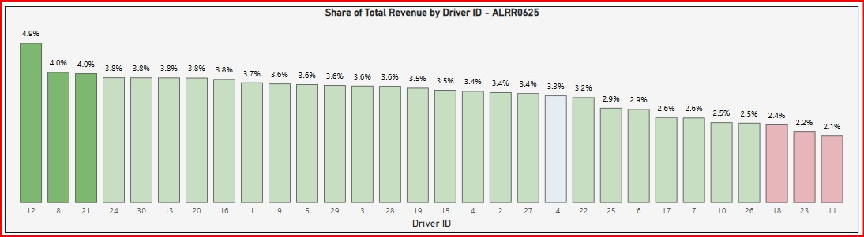
33% of our drivers are performing below average
Insights
Average Revenue per driver – 3.3% (25K)
Drivers below average revenue – 33% (10)
Top 3 drivers – 12, 8 and 21
Bottom 3 drivers – 18, 23 and 11

Slide 8
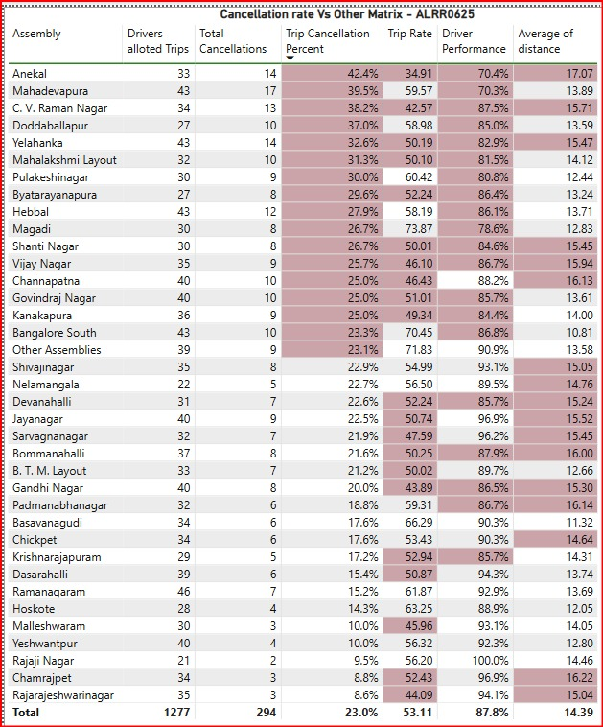
Nearly half of the locations exceed the average cancellation rate
Insights
46% (17) of locations have cancellation rate above average (23%). Following locations show a trend of low Driver performance (more cancellations from Drivers) because of low Fair per KM w.r.t. high distance:
Anekal – 42.4%
C V Raman Nagar – 38.2%
Yelahanka – 32.6%
Shanti Nagar – 26.7%
Vijayanagar – 25.7%
Channapatna – 25%

Slide 9
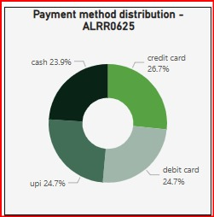
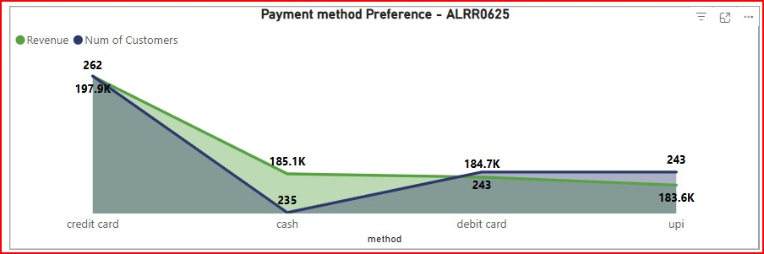
Encourage customers to opt for Digital payment methods
Insights
Insights
Digital transactions – 76% (Credit Card > Debit Card > UPI) outperformed Cash transactions – 24%.
Unusual revenue distribution — 185.1K of revenue for 235 rides suggests that while fewer customers use cash, their trips tend to be high-value rides

Slide 10
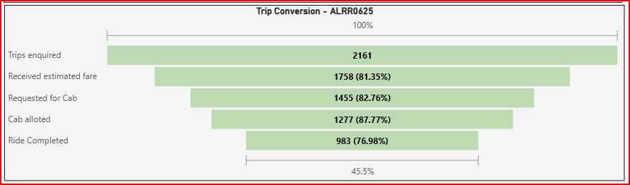
Recommendations
Revenue generation
Offer targeted discounts or cashbacks for rides during Early Morning, Evening, Night, and Midnight windows.
Time slots between 4 PM and 8 PM show higher average fares but generate relatively lower revenue indicating underutilization from both operational and marketing standpoints
Drivers’ performance
Driver incentivization program to improve performance
Rides cancellation
Addressing driver and customer cancellations can improve ride completion to 59%.
Payment methods
Encourage Digital Alternatives for High-Value Rides- Offering exclusive discounts or smoother checkout for high-value transactions on Digital payment methods
Ride conversion rate
Reducing wait-times by better driver allocation can further improve the completion rate to 67%
Experiment with A/B tests for ride suggestion algorithms and booking flows to increase conversions to 80%

Slide 11
Appendix – Data Source
Tables information
The dataset comprises five tables: Assembly - storing assembly zone details, Duration - providing time period identifiers, Payment - detailing payment methods, Trip Details - capturing trip request and status information and Trips - containing core trip data like fare, locations, and IDs.
Variables information
This data dictionary outlines key variables for analyzing trip data. It includes unique identifiers for assemblies, durations, payments, and trips. Details cover trip requests, price estimates, driver searches, cancellations, OTP entry, ride completion, fare information, locations, and involved parties like drivers and customers.

Slide 12
Appendix – Data Methodology & Data Assumptions
Data Methodology
We conducted a thorough analysis of the trip data and trip details fact data. The process included:
Analyzed data by applying logical filters and used Matrix table to establish various logics for creating measures
Using Column quality and Column distribution options, analytically tried to explore errors, duplicates values and data type of each column in all the tables. Ensured relevant headers are promoted in each table before loading to Model view.
We identified two tables’ Trips and Trips_Details as fact tables and Assembly, Duration and Payment tables as dimension tables. We created fact constellation schema, where we both the facts tables are sharing the data from one or many dimension tables
We established one-to-many cardinality between the tables to ensure data integrity, allowing for accurate data aggregation and meaningful analysis
Data Assumptions
Conversation rate metric calculates the % of rides that successfully completed out of total number of inquiries (searches) i.e. Sum of end_rides / Sum of searches
A trip is considered as cancelled if ride is not completed after driver allotment i.e. sum of Searches_got_quote minus sum of end_rides
For each TripId, distance covered by the driver is considered as optimized distance

